Slide 1
Understanding Vaccine Acceptance
Ryan Johnson

Slide 2

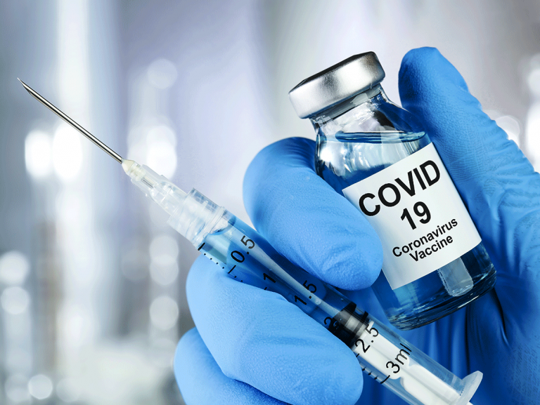
Problem
New Vaccines Have Lower Adoption Rates
Higher Vaccine Rates Contain Outbreaks Quicker
Lower Loss of Life and Economic Impact
COVID-19

Slide 3



Stakeholders
Governments
Medical Professionals
Business Leaders
In Short Everyone!

Slide 4
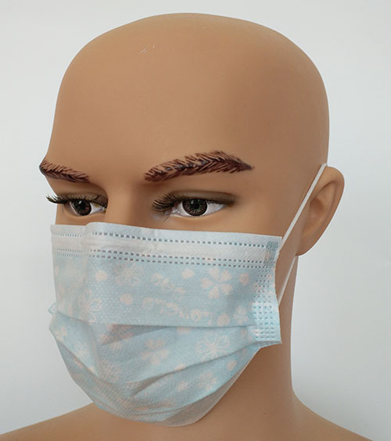
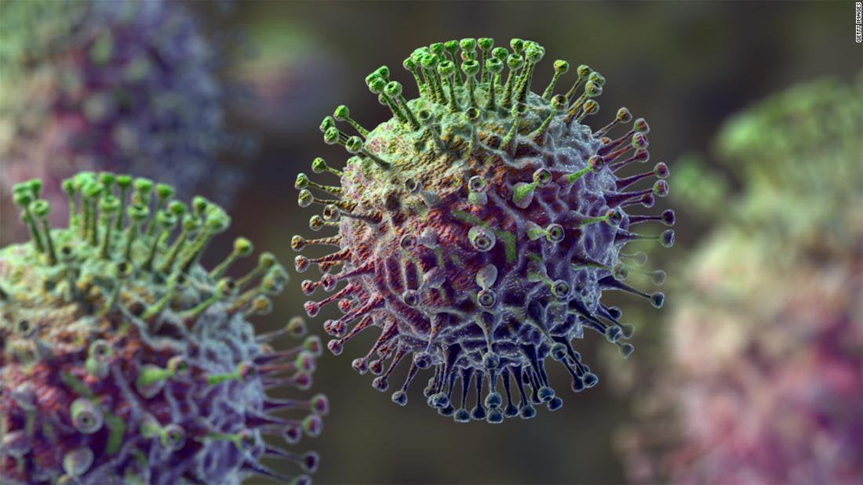
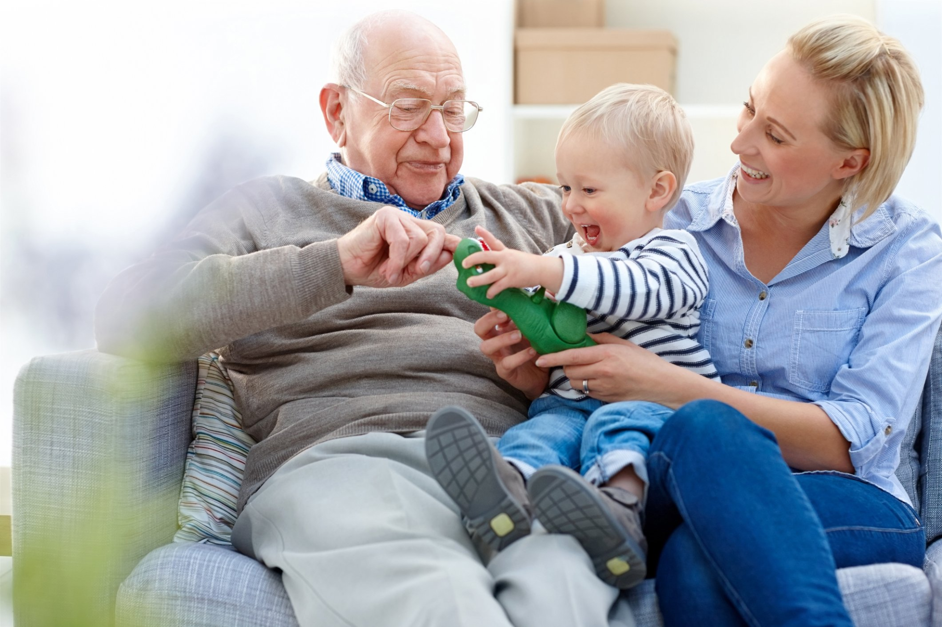
Factors
Behavior
Hand Washing
Gathering Attendance
Face Mask Use
Opinions
Severity of Virus
Effectiveness of Vaccine
Demographics
Age
Income
Household Makeup

Slide 5

Data
National 2009 H1N1 Flu Survey
26707 Observations
37 Features
Seasonal Flu & H1N1 Vaccine Target Labels
Data Wrangling
Eliminated Arbitrary Region, Industry & Occupation Values
Assigned Categorical Value to Invalid Entries

Slide 6
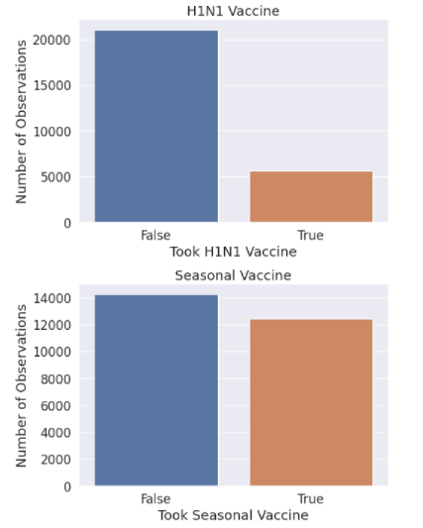
Initial Analysis
Imbalanced Data for H1N1

Slide 7
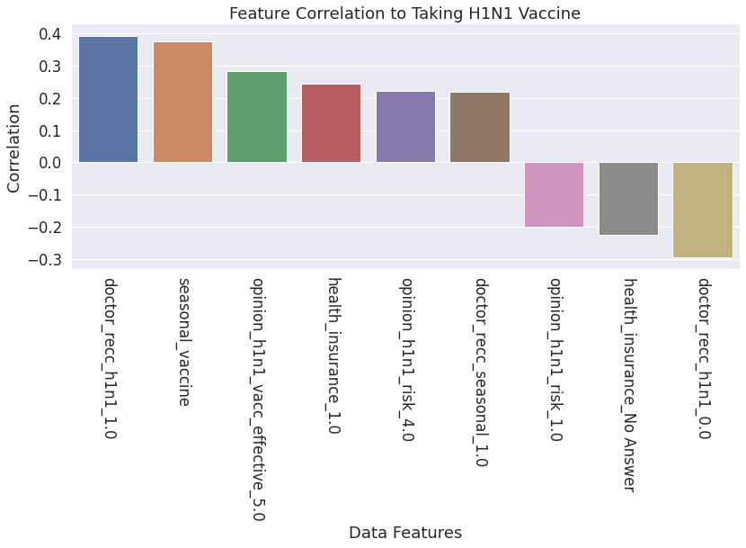
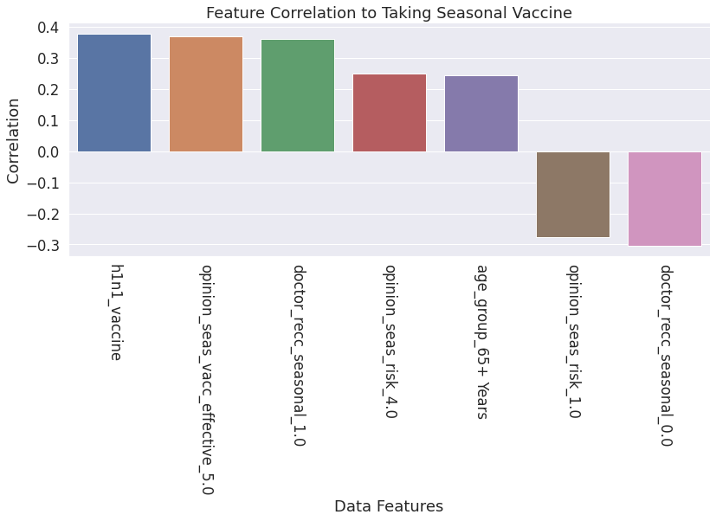
Initial Analysis Continued
Feature Correlation
Positive & Negative

Slide 8
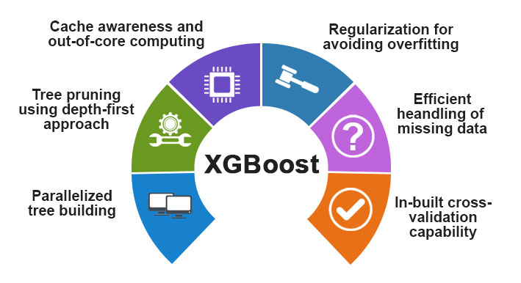
Modeling Analysis
Imbalanced Data
SMOTE
Classification Algorithm
Grid Search

Slide 9
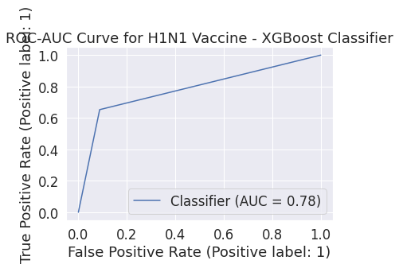
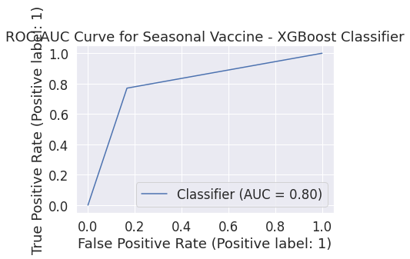
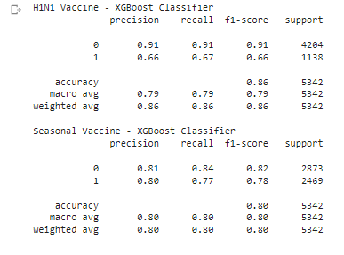
Modeling Analysis Continued
Random Forest
Naive Bayes
XGBoost

Slide 10
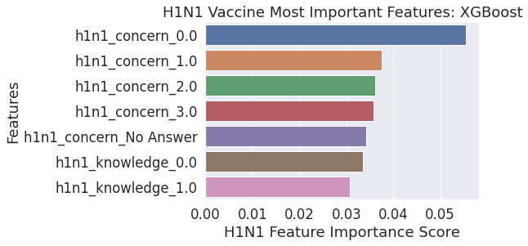
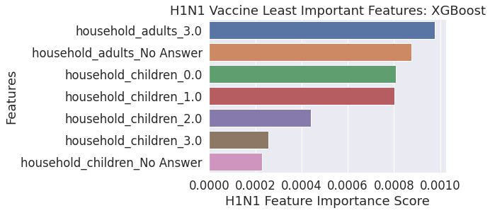
Modeling Analysis Continued

Slide 11



Findings
Trust
Knowledge
Fear
Physician Engagement

